Slide 1
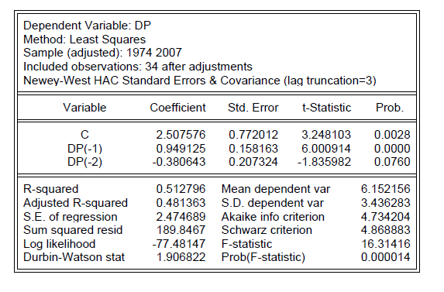
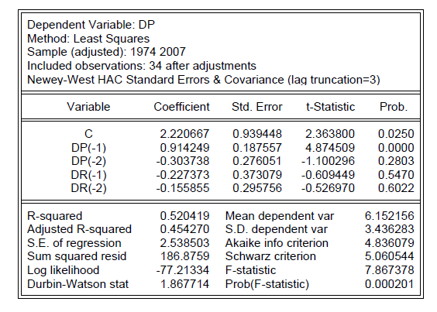
CHAPTER 4
TOOLS OF THE FORECASTER
4.1 The Information Set
4.1.1 Some Information Sets Are More Valuable than Others
Table 4.1 OLS Regression Results: House Prices and Mortgages Rates
Model (i)
Model (ii)
González-Rivera: Forecasting for Economics and Business, Copyright © 2013 Pearson Education, Inc.

Slide 2
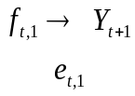
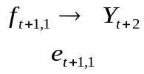
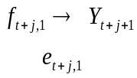
4.2.1 Forecasting Environments
Figure 4.1 Forecasting Environments: Recursive Scheme
One-step ahead
prediction at
time
t
Estimation sample
(t observations)
Prediction sample
0
t
t+1
T
Estimation sample
(t+1 observations)
Prediction sample
0
t+1
t+2
T
t +1
.
.
.
.
.
.
.
.
Estimation sample
(t+j observations)
Prediction sample
t +j
0
t+j
t+j+1
T
González-Rivera: Forecasting for Economics and Business, Copyright © 2013 Pearson Education, Inc.

Slide 3


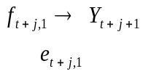
Figure 4.2 Forecasting Environments: Rolling Scheme
One-step ahead
prediction at
time
t
Estimation sample
(t observations)
Prediction sample
0
t
t+1
T
Estimation sample
(t observations)
Prediction sample
t +1
0
1
t+1
t+2
T
.
.
.
.
.
.
.
.
Estimation sample
(t observations)
Prediction sample
t+j
0
j
t+j
t+j+1
T
González-Rivera: Forecasting for Economics and Business,
Copyright © 2013 Pearson Education, Inc.

Slide 4


Figure 4.3 Forecasting Environments: Fixed Scheme
One-step ahead
prediction at
time
t
Estimation sample
(t observations)
Prediction sample
0
t
t+1
T
Estimation sample
(t observations)
Update
Prediction sample
t+1
0
t
t+1
t+2
T
.
.
.
.
.
.
.
.
Estimation sample
t observations)
Update information set
Prediction sample
t+j
0
t
t+1
…………
t+j
t+j+1
T
González-Rivera: Forecasting for Economics and Business, Copyright © 2013 Pearson Education, Inc.

Slide 5


4.3 The Loss Function
4.3.2 Examples
Figure 4.4 Symmetric Loss Functions
Quadratic loss function Absolute value loss function
L(e)
L(e)
0
e
0
e
González-Rivera: Forecasting for Economics and Business, Copyright © 2013 Pearson Education, Inc.

Slide 6

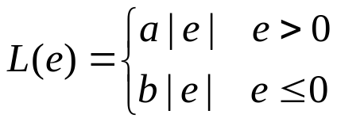



Figure 4.5 Asymmetric Loss Functions
Linex function
Lin-lin function
L(e)
L(e)
0
e
L(e)
0
e
0
e
González-Rivera: Forecasting for Economics and Business, Copyright © 2013 Pearson Education, Inc.

Slide 7



4.3.3 Optimal Forecast: An Introduction
Figure 4.6 The Forecasting Problem
……….
Conditional density
…..
1
2
3
4
t
t+h
time
time
Information set
González-Rivera: Forecasting for Economics and Business, Copyright © 2013 Pearson Education, Inc.

Slide 8



Figure 4.7 Optimal Forecast Under Quadratic Loss
……….
…..
1
2
3
4
t
t+h
time
Information set
González-Rivera: Forecasting for Economics and Business, Copyright © 2013 Pearson Education, Inc.

